Slide 1
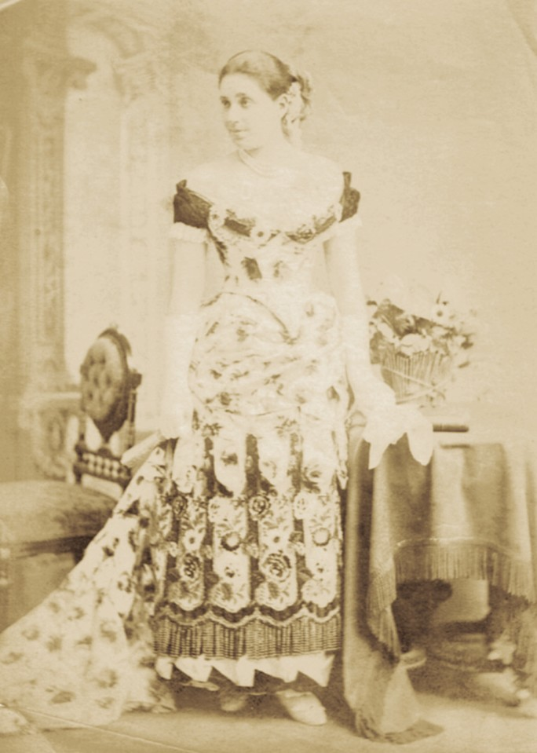
Farha (Flora) Sassoon
Bombay, 1890’s

Slide 2
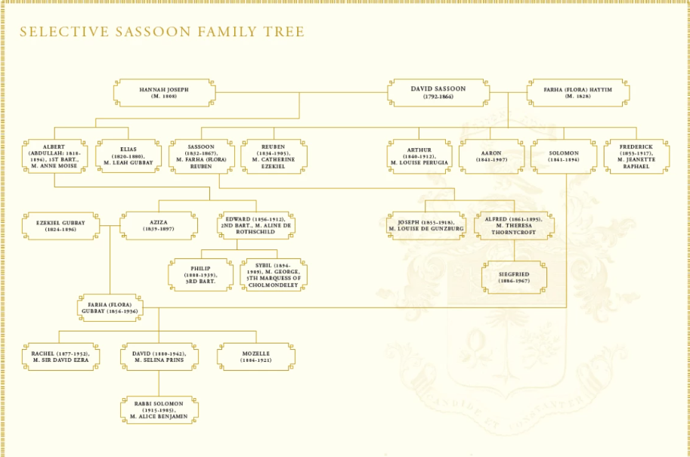

Slide 3
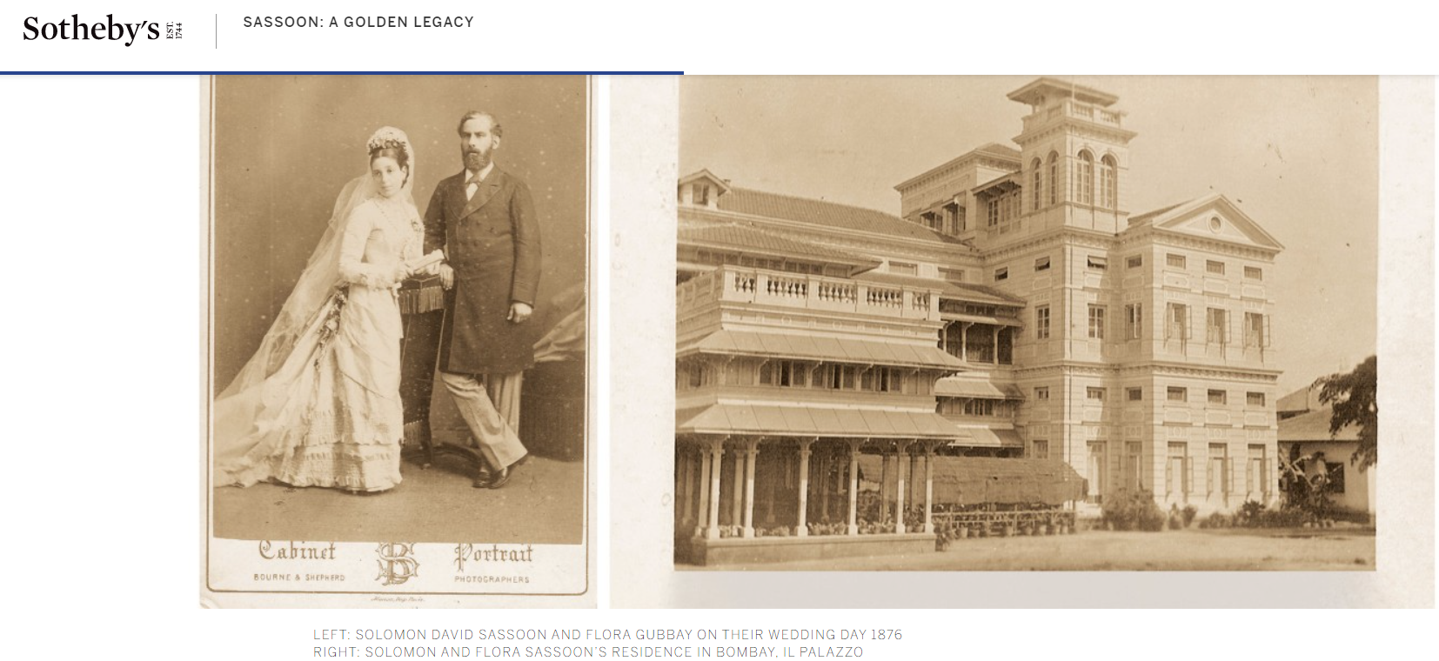

Slide 4
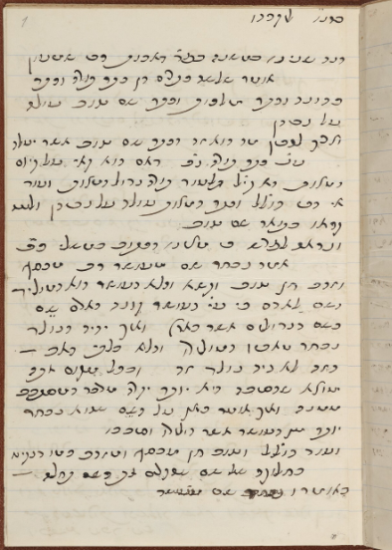
Ben Ish Hai eulogy for Solomon Sassoon, 1894

Slide 5
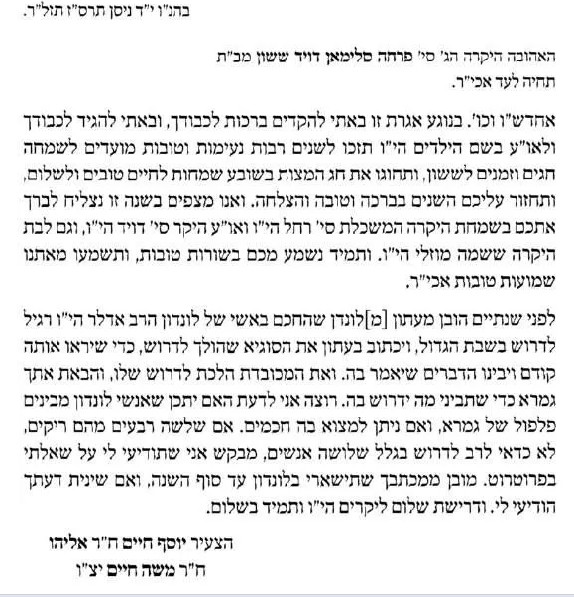
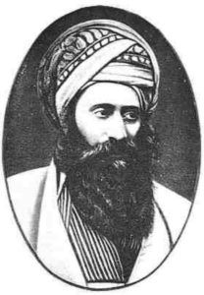
Personal
Correspondence
(1906)
R. Yosef Hayyim of
Baghdad

Slide 6
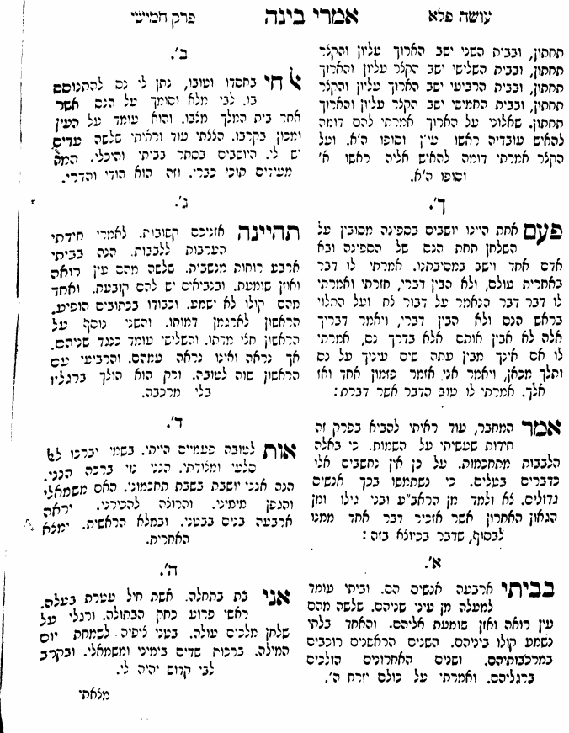
Imrei Binah
R. Yosef Hayyim of
Baghdad

Slide 7
Imrei Binah R. Yosef Hayyim of Baghdad
Twice I was a sign for goodness In my name, bless God my Rock and Fortress Behold, I am surely a beautiful blessing Behold, I dwell in the seat of my wisdom With mother to my left and vines to my right. And those who wish to know me, should see the four children in my belly And with the fullness of the first will the last be found | אוֹת לְטוֹבָה פַּעֲמַיִם הָיִיתִי בִּשְׁמִי יְבָרְכוּ לְאֵל סַלְעִי וּמְצוּדָתִי הִנְנִי נוֹי בְּרָכָה הִנֵּנִי הִנֵּה אָנֹכִי יוֹשֶׁבֶת בְּשֶׁבֶת תַּחְכְּמֹנִי הָאֵם מִשְּׂמֹאלִי וְהַגֶּפֶן מִיְּמִינִי וְהָרוֹצֶה לְהַכִּירֵנִי יִרְאֶה אַרְבָּעָה בָּנִים בְּבִטְנִי וּבִמְלוֹא הָרֵאשִׁית יִמְצָא הָאַחֲרִית
Chida of the Ben Ish Hai for Farha Sassoon
Line 1: The root “perah” is used twice in Tanakh as a symbol of goodness
Line 2: The blessing on new trees is only for those with flowering fruits
Line 3: The gematria (numeric value) of “Farha” is 293 which equals “noi berakha”
Lines 4 &5 allude to the wisdom of Shelomo HaMelekh, and of course to Farha. The term “farah” is used in Shir HaShirim.
Line 6: This is a play on the name Farha, which has 4 letters. The two middle (“belly”) letters (resh and het) have the same numeric value as the word “ben”, son times 4 (208).
Line 7: The first letter is “feh”, which written “fully” with the last letter, is “mouth”

Slide 8
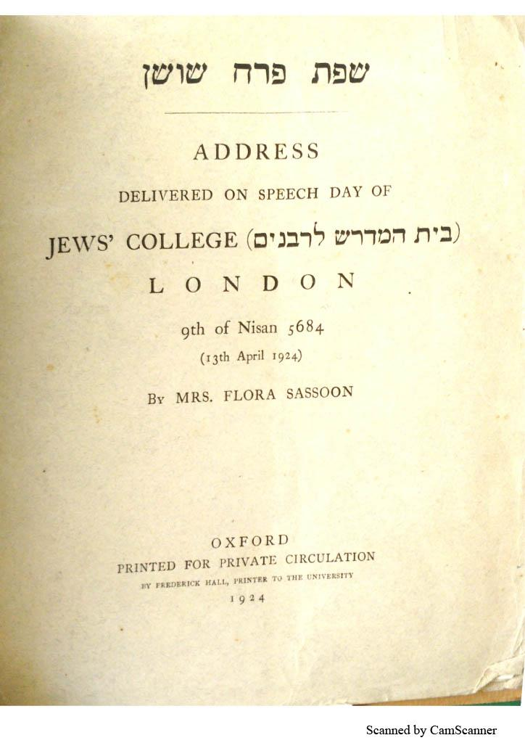
Notes:
In 1924 she presided over Speech Day at Jews' College, the institution for training rabbis, in London, proclaiming it to be 'a great honour to be the first lady-chairman at an Annual Speech Day.

Slide 9
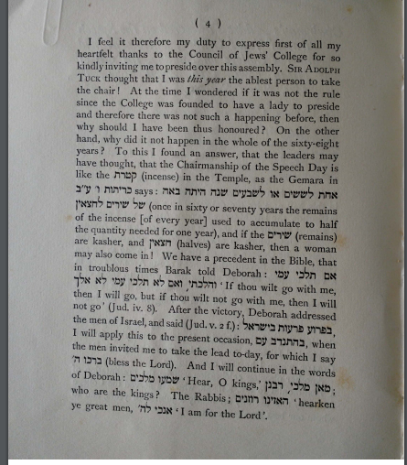

Slide 10
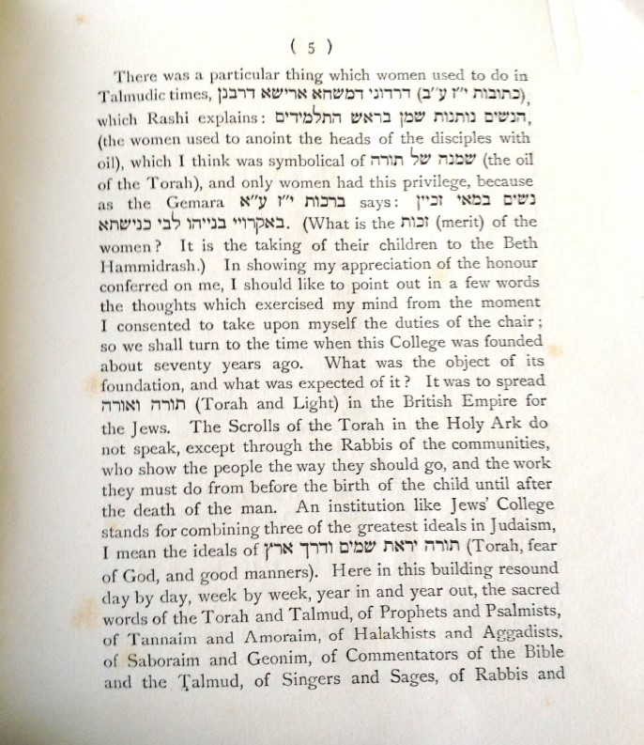

Slide 11
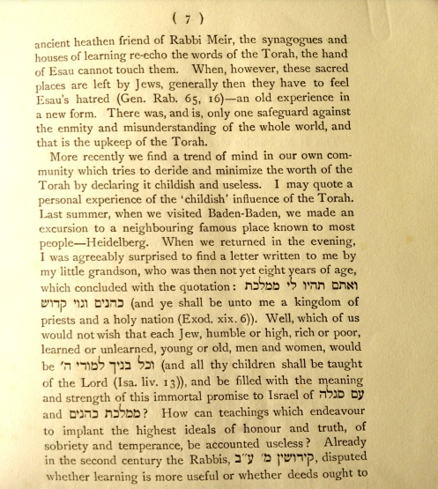

Slide 12
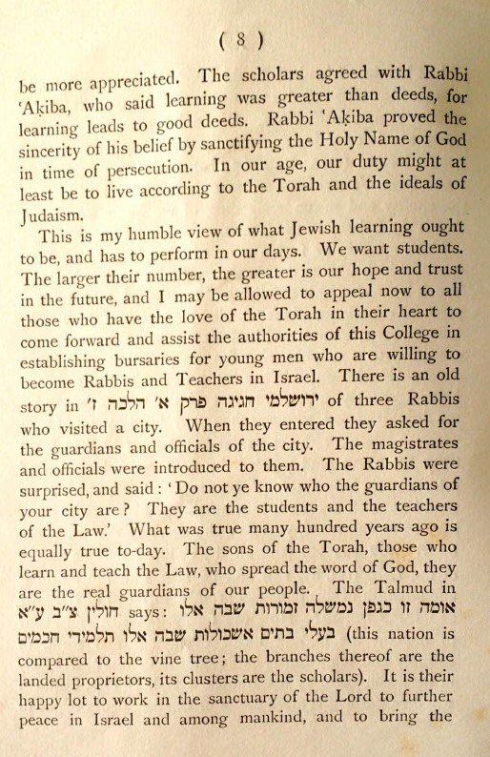

Slide 13
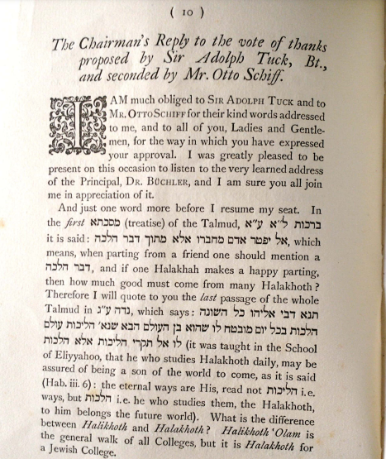

Slide 14
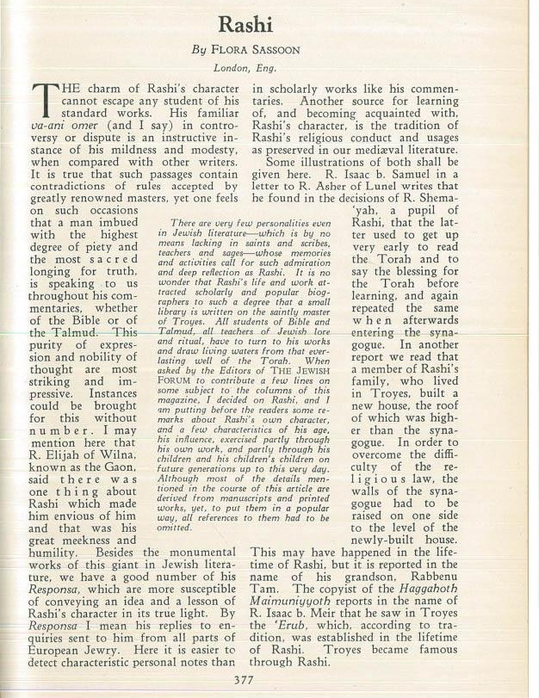

Slide 15
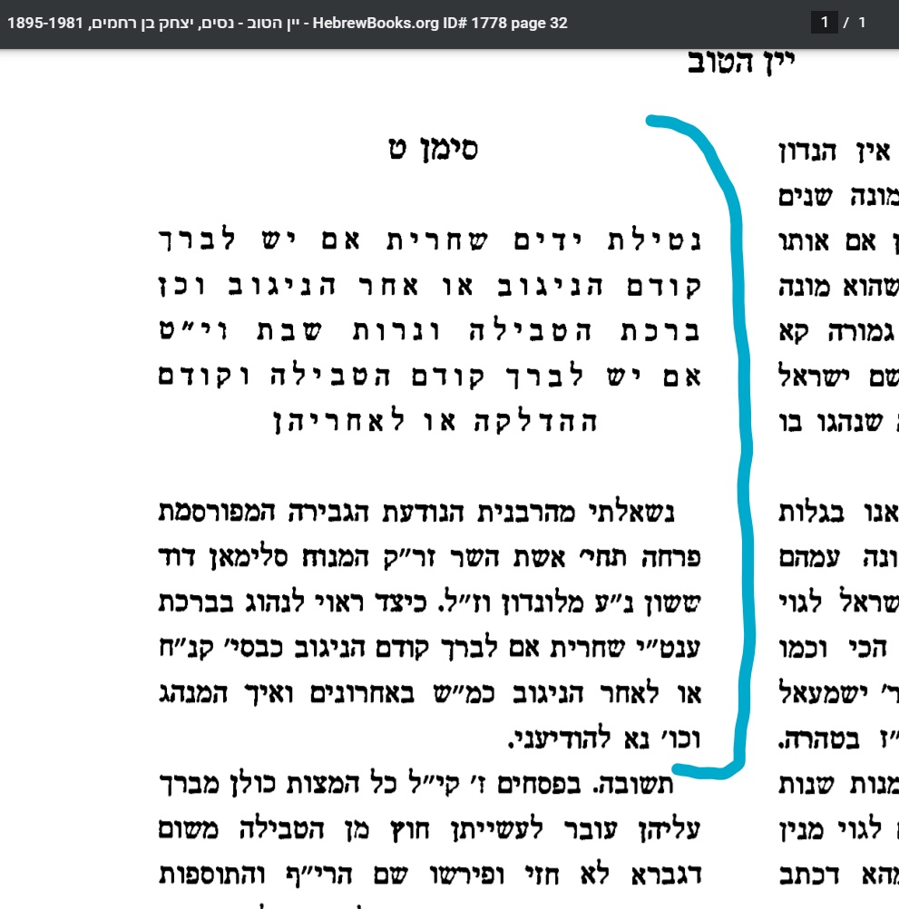
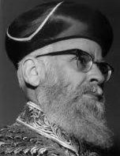
Y
R
Responsa Yayin HaTov
R. Yitshak ben Rahamim Nissim
Notes:
https://drive.google.com/file/d/1BrJNEAQkcsoLDKM_cGc1XpkKNbYYLsAl/view?usp=sharing

Slide 16
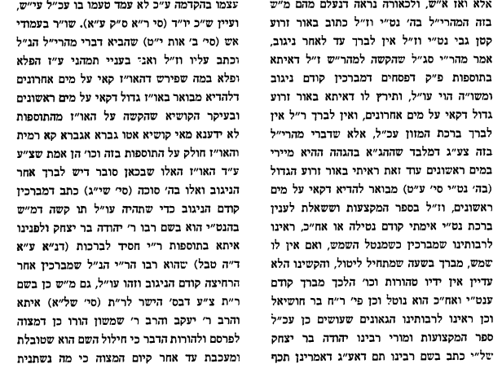
Responsa Yayin HaTov
R. Yitshak ben Rahamim Nissim
Notes:
https://drive.google.com/file/d/1BrJNEAQkcsoLDKM_cGc1XpkKNbYYLsAl/view?usp=sharing

Slide 17
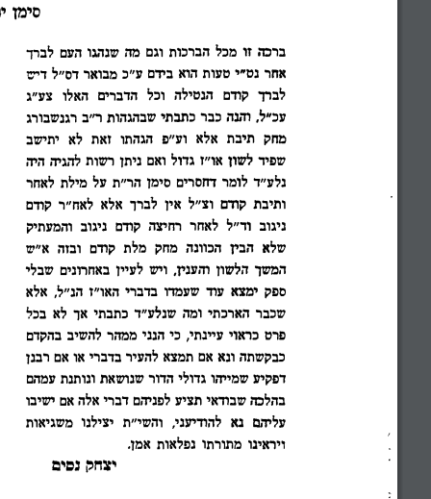
Responsa Yayin HaTov
R. Yitshak ben Rahamim Nissim
Notes:
https://drive.google.com/file/d/1BrJNEAQkcsoLDKM_cGc1XpkKNbYYLsAl/view?usp=sharing

Slide 18
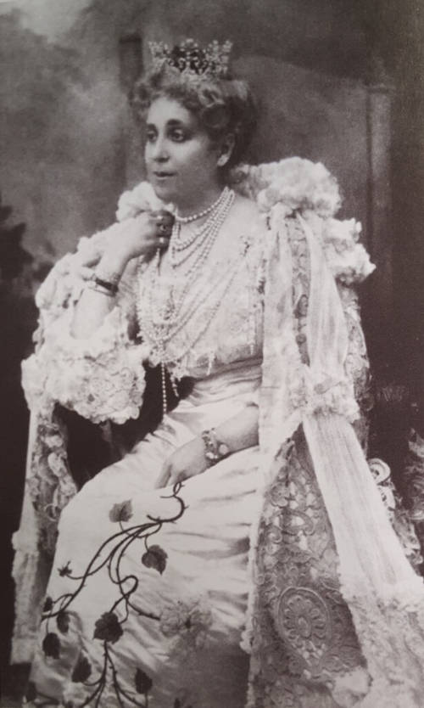
Farha (Flora) Sassoon

Slide 19
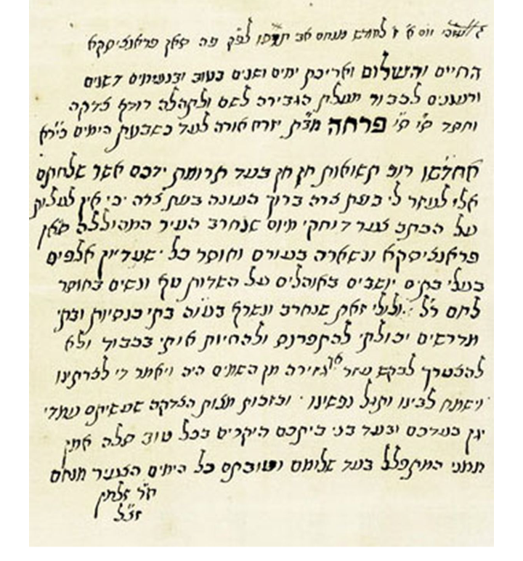
Autograph Letter Signed in Hebrew (in Rashi script) written to philanthropist Farha [Flora] Sassoon from Menachem ch[athan] R. Zalman.
Acknowledgment of financial aid in the wake of the San Francisco Earthquake of April 18th, 1906.

Slide 20
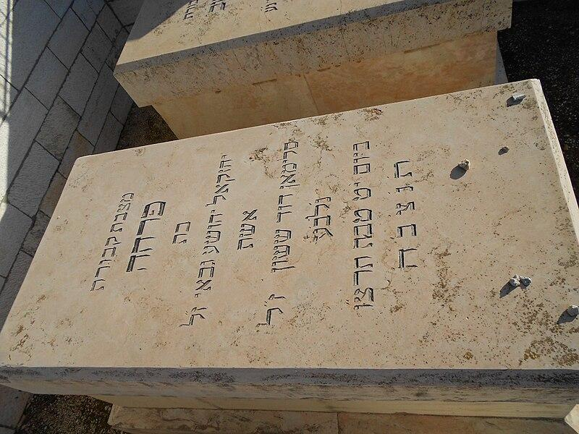
Flora Sassoon passed away on 19 Tevet, 1936.
Chief Rabbi Herzog’s hesped described her as “a living well of Torah, of piety, of wisdom, of goodness and charity, of the staunchest loyalty to tradition, and out of her wonderful well Israel could draw in abundance noble incentives and lofty inspiration.”

Slide 21
Some Further References:
JWA Article on Flora Sassoon with Bibliography for Further Reading
Haham Yomi Entry
Sotheby’s Sassoon Family Collection
Article on another notable Sassoon relative: Rachel Sassoon

