Slide 1
Mishnah In-Depth: Kiddushin (3)
Drisha 2024

Slide 2
A. review:
The focus of the current series was to discuss the general structure of the Tractate Kiddushin (and not particular Halakhot in the Tractate).
Session #1> 1st Chapter > The קניינים and the מצוות units.
Session #2> 2nd Chapter: The shift from קניין to קידושין
Guiding Theory: Technical > Meaningful explanations.

Slide 3
B. Survey: Kiddushin Chapter 2
Introduction: The Kiddushin Process

Slide 4
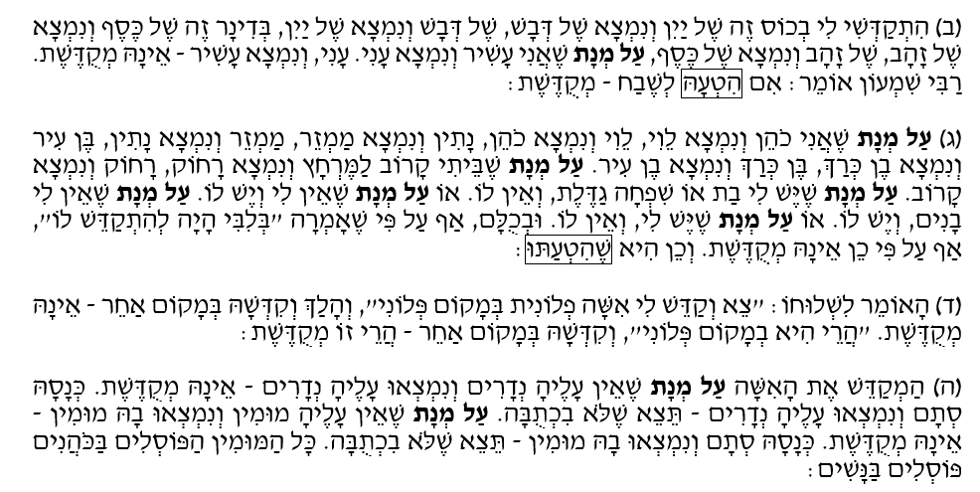
B. Survey: Kiddushin Chapter 2
Misleading Kiddushin: Object, Identity, Process

Slide 5
B. Survey: Kiddushin Chapter 2
Kiddushin of Multiple Wives

Slide 6
B. Survey: Kiddushin Chapter 2
The Ownership over the Object used for the Kiddushin

Slide 7
C. Survey: Kiddushin Chapters 3-4
Conditional and Misleading Kiddushin

Slide 8
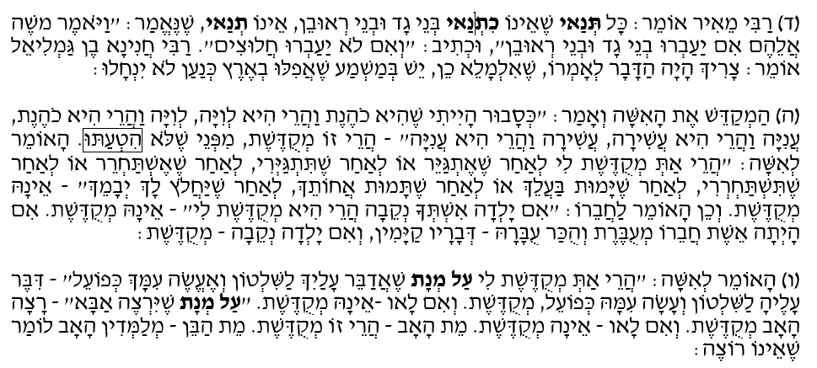
C. Survey: Kiddushin Chapters 3-4
Conditional and Misleading Kiddushin

Slide 9
C. Survey: Kiddushin Chapters 3-4
Doubts surrounding the Kiddushin

Slide 10
C. Survey: Kiddushin Chapters 3-4
Doubts surrounding the Kiddushin

Slide 11
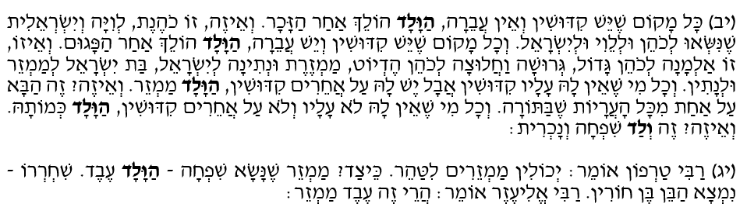
C. Survey: Kiddushin Chapters 3-4
ולד Ancestry / Lineage:

Slide 12
C. Survey: Kiddushin Chapters 3-4
לבוא זה בזה Ancestry / Lineage :

Slide 13
C. Survey: Kiddushin Chapters 3-4
כהונה Ancestry / Lineage :

Slide 14
C. Survey: Kiddushin Chapters 3-4
נאמנות Ancestry / Lineage :

Slide 15
C. Survey: Kiddushin Chapters 3-4
Doubts surrounding the Kiddushin

Slide 16
C. Survey: Kiddushin Chapters 3-4
נאמנות Ancestry / Lineage :

Slide 17
C. Survey: Kiddushin Chapters 3-4
יחודSeclusion :

Slide 18
C. Survey: Kiddushin Chapters 3-4
אומנותProfession :

Slide 19
C. Survey: Kiddushin Chapters 3-4
אומנותProfession:

Slide 20
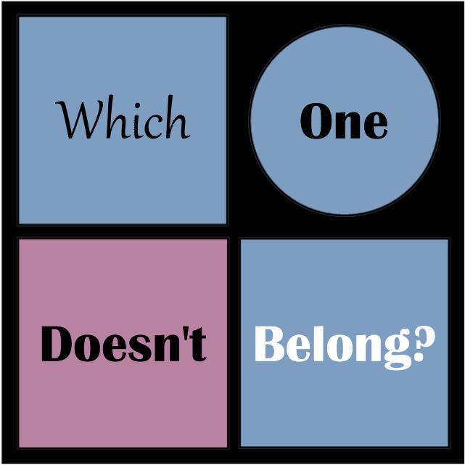
D. Which Units do not Belong Here?

Slide 21
D. Which Units do not Belong Here?
Ancestry /Lineage Unit
יוחסין

Slide 22
D. Which Units do not Belong Here?
The Seclusion Unit:
ייחוד

Slide 23
D. Which Units do not Belong Here?
The Profession Unit:
אומנות

Slide 24
D. Which Units do not Belong Here?

Slide 25
F. Seclusion / Profession

Slide 26
F. Seclusion / Profession
(ח) הָאוֹמֵר: "בְּנִי זֶה מַמְזֵר" - אֵינוֹ נֶאֱמָן...
(יב) לֹא יִתְיַחֵד אָדָם עִם שְׁתֵּי נָשִׁים....
(יד) ... כָּל שֶׁעִסְקוֹ עִם הַנָּשִׁים, לֹא יִתְיַחֵד עִם הַנָּשִׁים. וְלֹא יְלַמֵּד אָדָם אֶת בְּנוֹ אֻמָּנוּת בֵּין הַנָּשִׁים.
(4:8) If a man declares, “this son of mine is a mamzer,” he is not believed…
(4:12) One man may not be secluded with two women…
(4:14) Whoever's business is with women should not be alone with women. And one should not teach his son a profession that would cause him to be among women…

Slide 27
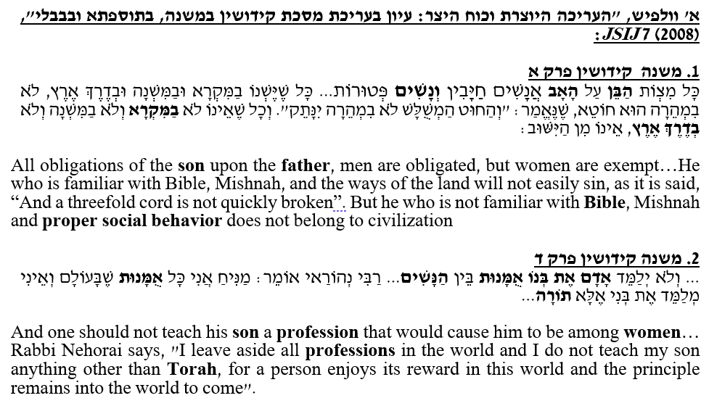
E. Seclusion / Profession

Slide 28
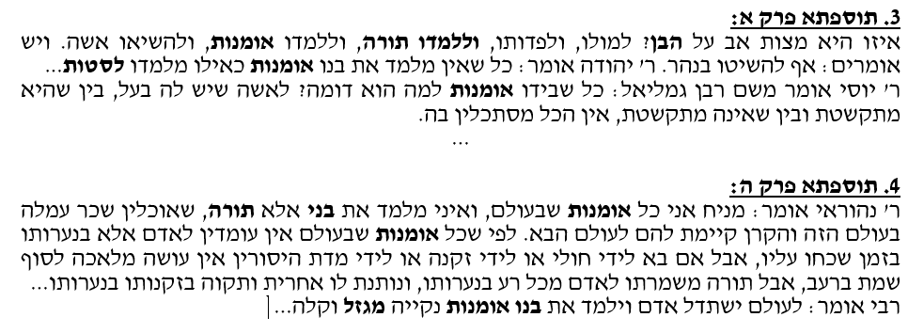
E. Seclusion / Profession

Slide 29
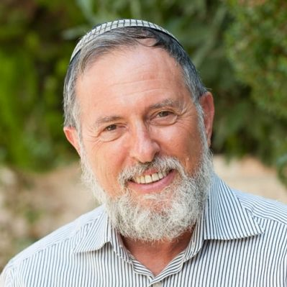
E. Seclusion / Profession

Slide 30
E. Seclusion / Profession

Slide 31
E. Seclusion / Profession

Slide 32
F. Ancestry / Lineage

Slide 33
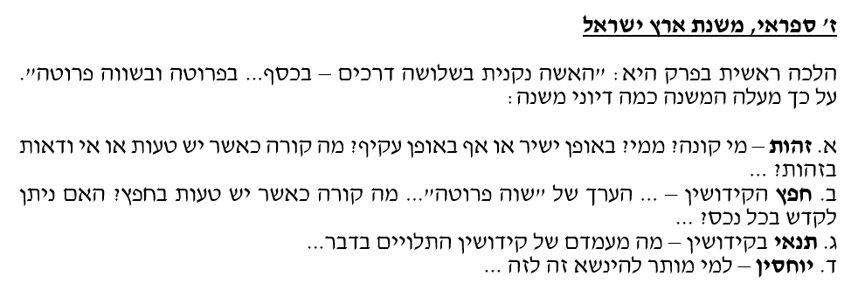
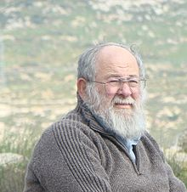
F. Ancestry / Lineage

Slide 34
F. Ancestry / Lineage

Slide 35
G. Lineage vs. Profession?

Slide 36
G. Lineage vs. Profession?

Slide 37
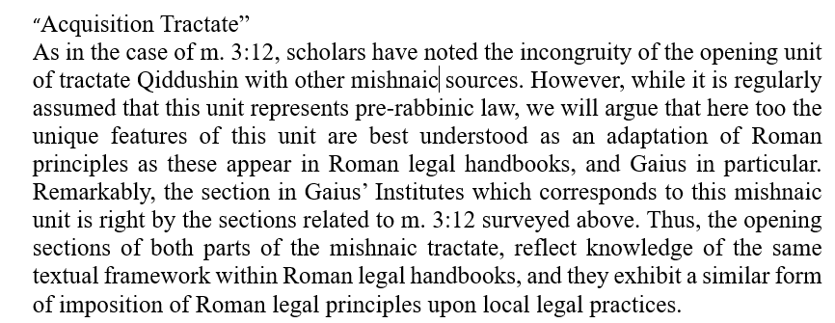
Appendix: Between Jewish and Roman Law

Slide 38
כָּל הָעוֹשֶׂה מִצְוָה אַחַת, מְטִיבִין לוֹ וּמַאֲרִיכִין לוֹ יָמָיו וְנוֹחֵל אֶת הָאָרֶץ.

Slide 39
שיעור # 3: שיעור פתיחה חלק ג פרקים שלישי - רביעי במסכת קידושין קיץ תשפ"ד

Slide 40
שיעור # 3: שיעור פתיחה חלק ג פרקים שלישי - רביעי במסכת קידושין קיץ תשפ"ד

