Slide 1
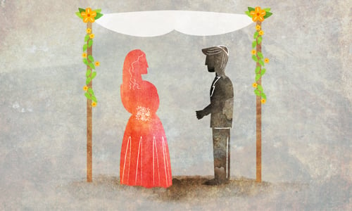
Mishnah In-Depth: Kiddushin (2)
Drisha 2024

Slide 2
A. Review: Kiddushin Chapter 1
A woman is acquired in three ways and acquires herself in two: She is acquired by money, by document, or by intercourse. “By money”: Bet Shammai says: a denar or the equivalent of a denar; Bet Hillel says: a perutah or the equivalent of a perutah. And how much is a perutah? An eighth of an Italian issar. And she acquires herself by divorce or by her husband's death. A yevamah is acquired by intercourse. And she acquires herself by halitzah or by the yavam’s death.

Slide 3
B. Kiddushin Chapter 2
Kiddushin Process: Introduction

Slide 4
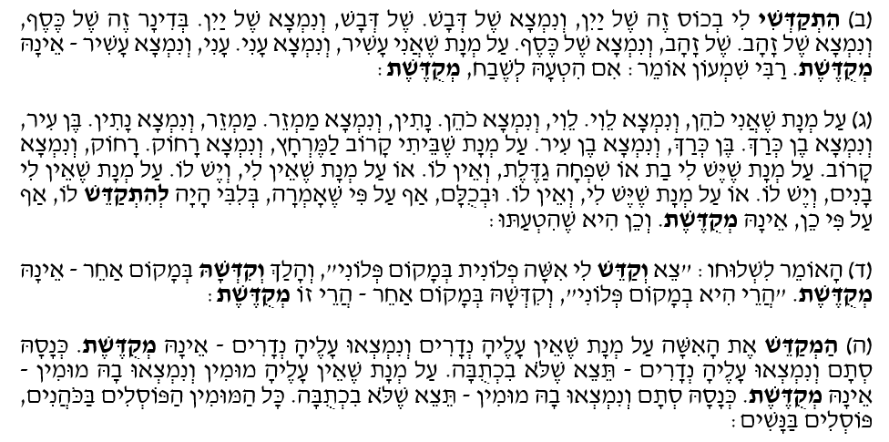
B. Kiddushin Chapter 2
Misleading Kiddushin: Object, Identity, Process

Slide 5
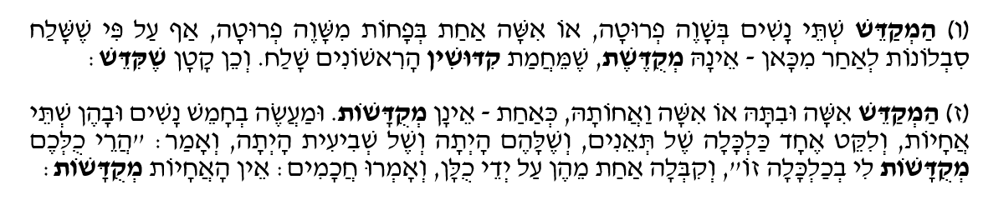
B. Kiddushin Chapter 2
Kiddushin of Multiple Wives

Slide 6
B. Kiddushin Chapter 2
The Ownership over the Object used for the Kiddushin

Slide 7
C. קניין vs. קידושין?
קניין
קידושין

Slide 8
D. קניין vs. קידושין? The Talmudic Sugiya
Why is it different here in that it states, “a woman is acquired (נקנית),” and elsewhere it teaches “A man betroths (מקדש)”?
Because he wishes to teach “money”; and from where is it derived that money? He derives it by connecting “taking” with the “taking” from the field of Ephron: Here it is written: “When a man takes a wife”, while it is written there: “I will give you money for the field: take it from me”, And “taking” is called acquisition, for it is written, “the field which Abraham acquired.”

Slide 9
D. קניין vs. קידושין? The Talmudic Sugiya
Then let him teach there, “A man acquires”? He [the Tanna] first taught Biblical language, but subsequently, rabbinic language. And what is the [meaning] of the Biblical language? That he [the husband] prohibits her to all [other men] like hekdesh.

Slide 10
E. The Chronological Approach: From קניין to קידושין

Slide 11
E. The Chronological Approach: Fromקניין to קידושין
3. י"נ אפשטיין, מבואות לספרות התנאים, עמ' 53
קידושין פרק ראשון של קידושין הוא מסכת לעצמה: פרק קניינים (של אשה, עבד, נכסים, חילופין) וחיובים (של אנשים ונשים, ארץ וחו"ל), עם סיום אגדי, כרגיל בסוף מסכות....
לשון פרק א עתיק וקצר... ובימים ההם "נקנית" האשה כמו ש"נקנה" העבד.

Slide 12
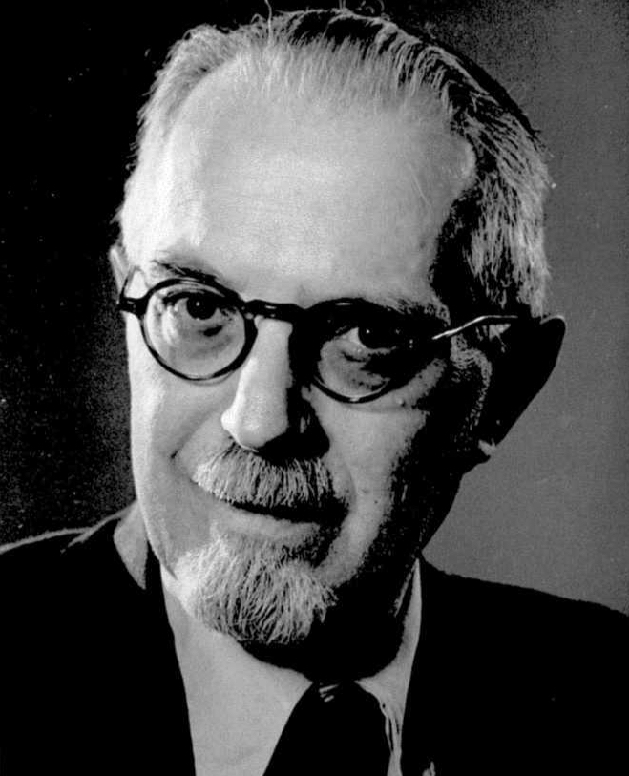
E. The Chronological Approach: Fromקניין to קידושין
4. א' וייס, "הצעת החומר במסכת קידושין, משנה ותוספתא", חורב יב, עמ' 81
לכן נראה שהמשניות שעל הקניינים הוא מקור קדום לעצמו. ממטרת מסדר מקור זה להציע כל דרכי קנין השונים ולסדרם מנקות ראות הדבר העומד להקנות. בזמן ההוא עדיין השתמשו לקידושין בלשון קניין.

Slide 13
E. The Chronological Approach: Fromקניין to קידושין

Slide 14
E. The Chronological Approach: Fromקניין to קידושין

Slide 15
E. The Chronological Approach: Fromקניין to קידושין?

Slide 16
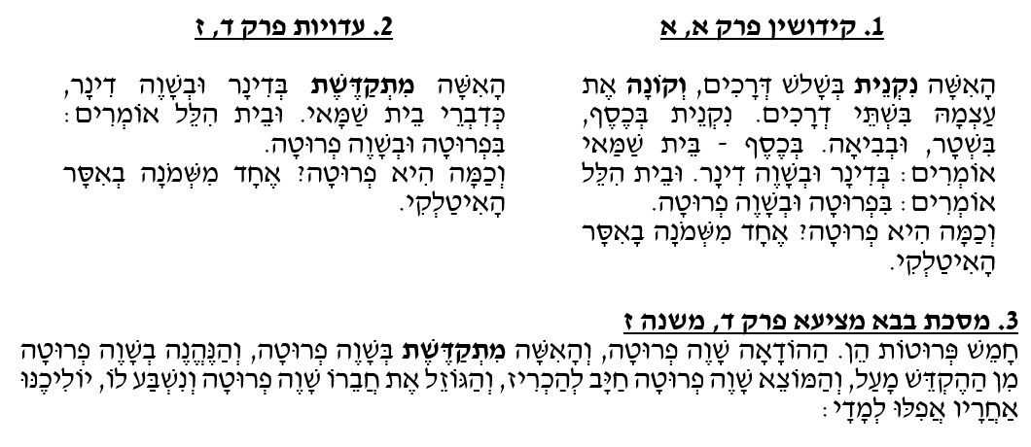
E. The Chronological Approach: Fromקניין to קידושין?

Slide 17
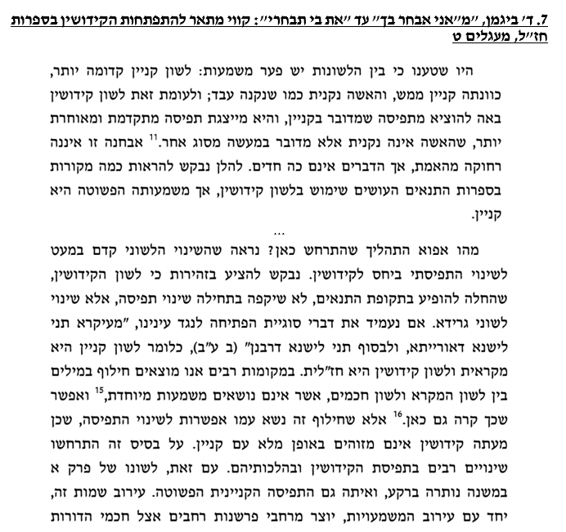
E. The Chronological Approach: Fromקניין to קידושין?

Slide 18
F. A Matter of Context: קניין & קידושין

Slide 19
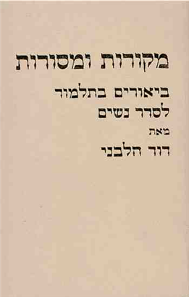
F. A Matter of Context: קניין & קידושין

Slide 20
G. Different Perspectives:קניין ≠ קידושין
Bet Shammai says: a man should not divorce his wife unless he has found her guilty of some unseemly conduct, as it says, “Because he has found some unseemly thing in her.” Bet Hillel says [that he may divorce her] even if she has merely burnt his dish, since it says, “Because he has found some unseemly thing in her.” Rabbi Akiva says, [he may divorce her] even if he finds another woman more beautiful than she is, as it says, “it cometh to pass, if she find no favour in his eyes”.

Slide 21
G. Different Perspectives:קניין ≠ קידושין

Slide 22
G. Different Perspectives:קניין ≠ קידושין

Slide 23
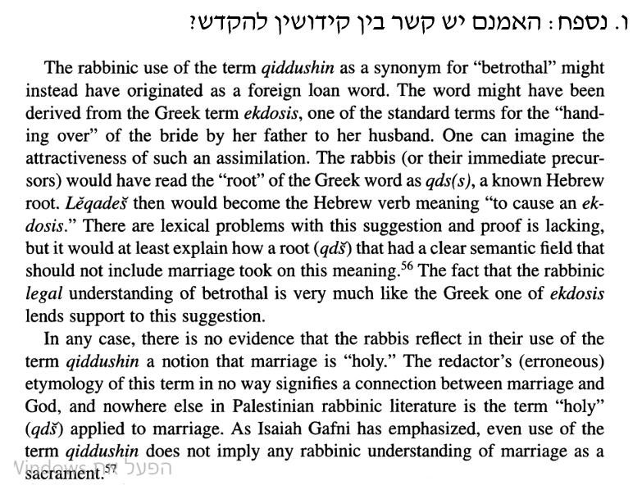
Appendix

Slide 24
Appendix

Slide 25
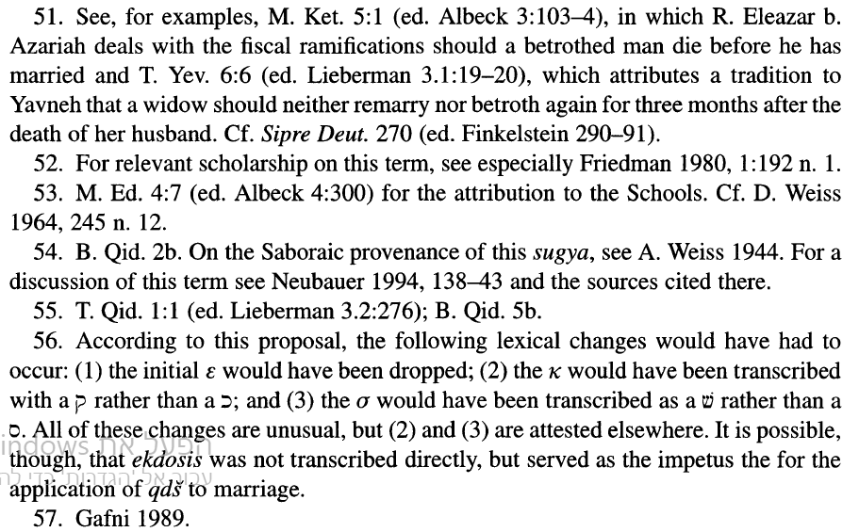
Appendix

Slide 26
Mishnah In-Depth: Kiddushin (2)
Drisha 2024

