Slide 1
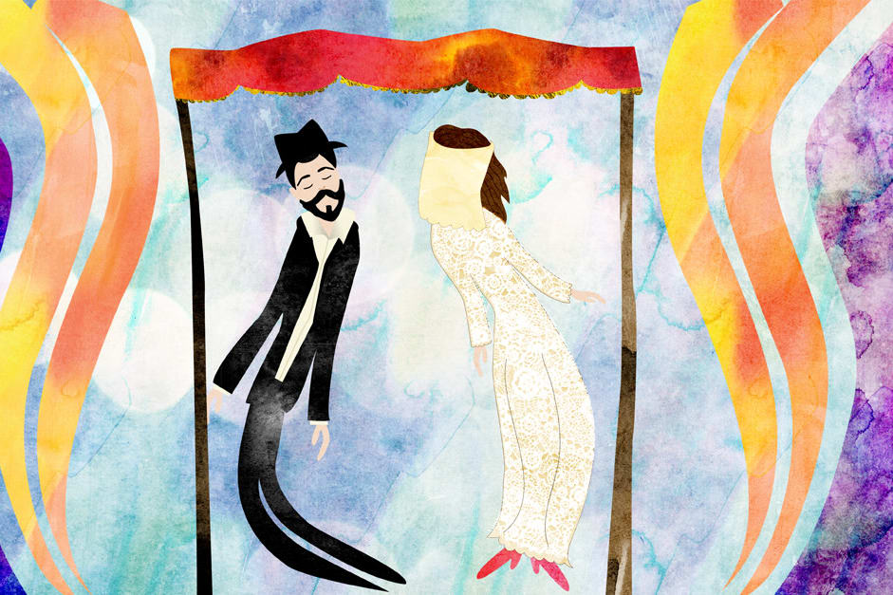
Mishnah In-Depth: Kiddushin
Drisha 2024

Slide 2
Mishnah In-Depth: Kiddushin Session # 1: Outline
The Name of the Tractate
The Location of Tractate Kiddushin in Seder Nashim
The Structure of the first chapter of Tractate Kiddushin

Slide 3
A. The Name of the Tractate

Slide 4
A. The Name of the Tractate

Slide 5
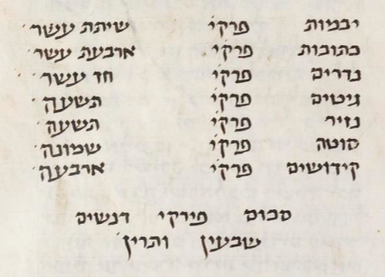
B. The Location of Tractate Kiddushin in Seder Nashim

Slide 6
B. The Location of Tractate Kiddushin in Seder Nashim
And after Sotah, he arranged Kiddushin. And it should be asked here, "For what reason did he arrange Kiddushin last, and it would have been correct for it to be arranged before Ketubot?"

Slide 7
B. The Location of Tractate Kiddushin in Seder Nashim
כִּֽי־יִקַּ֥ח אִ֛ישׁ אִשָּׁ֖ה וּבְעָלָ֑הּ וְהָיָ֞ה אִם־לֹ֧א תִמְצָא־חֵ֣ן בְּעֵינָ֗יו כִּי־מָ֤צָא בָהּ֙ עֶרְוַ֣ת דָּבָ֔ר וְכָ֨תַב לָ֜הּ סֵ֤פֶר כְּרִיתֻת֙ וְנָתַ֣ן בְּיָדָ֔הּ וְשִׁלְּחָ֖הּ מִבֵּיתֽוֹ׃ וְיָצְאָ֖ה מִבֵּית֑וֹ וְהָלְכָ֖ה וְהָיְתָ֥ה לְאִישׁ־אַחֵֽר׃
And the answer would be that its order was made like this because it was his desire to go according to the order of Scripture, which had divorce precede marriage. And that is what the Holy One, blessed be He, said "and he writes her a bill of divorce and he hands it to her [...] and she leaves his household, and she becomes the wife of another man…”.

Slide 8
B. The Location of Tractate Kiddushin in Seder Nashim
Jeremiah 3:1
If a man put away his wife, and she go from him, and become another man’s, may he return unto her again? Will not that land be greatly polluted? But thou hast played the harlot with many lovers; and wouldest thou yet return to Me! Said the LORD.

Slide 9
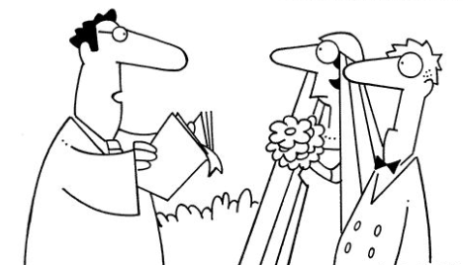
B. The Location of Tractate Kiddushin in Seder Nashim

Slide 10
B. The Location of Tractate Kiddushin in Seder Nashim

Slide 11
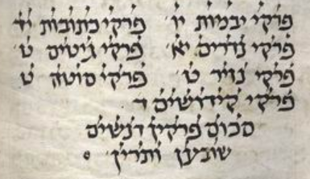
B. The Location of Tractate Kiddushin in Seder Nashim

Slide 12
C. The Structure of the First Chapter of Tractate Kiddushin
A woman is acquired in three ways and acquires herself in two: She is acquired by money, by document, or by intercourse. “By money”: Bet Shammai says: a denar or the equivalent of a denar; Bet Hillel says: a perutah or the equivalent of a perutah. And how much is a perutah? An eighth of an Italian issar. And she acquires herself by divorce or by her husband's death. A yevamah is acquired by intercourse. And she acquires herself by halitzah or by the yavam’s death.

Slide 13
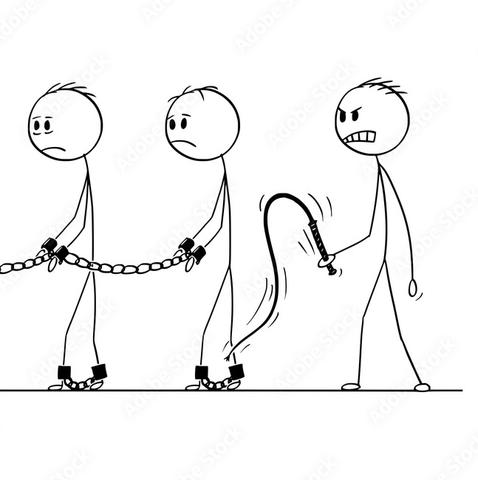
C. The Structure of the first chapter of Tractate Kiddushin
A Hebrew slave is acquired by money and by document; And acquires himself by years, by Jubilee, and by deduction from the purchase price. A Hebrew maidservant is greater in that she acquires herself by ‘signs [of physical maturity]’. He whose ear is bored is acquired by boring, and acquires himself by Jubilee or his master's death.

Slide 14
C. The Structure of the first chapter of Tractate Kiddushin
A Canaanite slave is acquired by money, deed, or by possession, And acquires himself by money through the agency of others, and by document through his own agency, the words of Rabbi Meir. The Sages say: by money, through his own agency, and by document, through the agency of others, providing that the money comes from others.

Slide 15
C. The Structure of the first chapter of Tractate Kiddushin
Large animals are acquired by being handed over and small animals by lifting, the words of Rabbi Meir and Rabbi Eliezer. The sages say: small animals are acquired by being led.

Slide 16
C. The Structure of the first chapter of Tractate Kiddushin
Property which has security is acquired by money, by deed or by possession. [Property] which does not have security is acquired only by being drawn [to the purchaser]. Property which does not have security may be acquired in conjunction with property which does have security by money, deed, or possession; And it obligates the property which provides security, to take an oath concerning them.

Slide 17
C. The Structure of the first chapter of Tractate Kiddushin
Whatever can be used as payment for another object, as soon as this one takes possession [of the object], the other one assumes liability for what is given in exchange. How so? If one exchanges an ox for a cow, or a donkey for an ox, as soon as this one takes possession, the other one assumes liability for what is given in exchange. The sanctuary’s title to property [is acquired] by money; the title of an ordinary person to property by hazakah. Dedication to the sanctuary is equal to delivery to an ordinary person.

Slide 18
C. The Structure of the first chapter of Tractate Kiddushin
All obligations of the son upon the father, men are obligated, but women are exempt. But all obligations of the father upon the son, both men and women are obligated. All positive, time-bound commandments, men are obligated, and women are exempt. But all positive non-time-bound commandments both men and women are obligated. And all negative commandments, whether time-bound or not time-bound, both men and women are obligated, except for, the prohibition against rounding [the corners of the head], and the prohibition against marring [the corner of the beard], and the prohibition [for a priest] to become impure through contact with the dead.

Slide 19
C. The Structure of the first chapter of Tractate Kiddushin
The [rites of] laying hands, waving, presenting [the meal-offering], taking the handful, burning [the fat], cutting [the neck of bird sacrifices], sprinkling and receiving [the blood] are performed by men but not by women, except the meal-offering of a sotah and a female nazirite, where they [themselves] wave the offering.

Slide 20
C. The Structure of the first chapter of Tractate Kiddushin
Every commandment which is dependent on the land is practiced both in and outside the land, except orlah and kilayim. Rabbi Eliezer says: also [the prohibition of] new produce.

Slide 21
C. The Structure of the first chapter of Tractate Kiddushin
He who performs one commandment dependent on the land is practiced only in the land [of Israel]; and every commandment which is not is rewarded, his days are prolonged, and he inherits the land, But he who does not perform one commandment, is not rewarded, his days are not prolonged, and he does not inherit the land.
He who is familiar with Bible, Mishnah, and the ways of the land will not easily sin, as it is said, “And a threefold cord is not quickly broken” (Ecclesiastes 4:12). But he who is not familiar with Bible, Mishnah and the ways of the land does not belong to civilization.

Slide 22
C. The Structure of the first chapter of Tractate Kiddushin
חלק ב: מצוות
1. מצוות איש / אישה
2. מצוות תלויות / שאינן תלויות בארץ
3. שכר מצוות
חלק א: קניינים
1. אישה
2. עבד עברי וכנעני
3. בהמה גסה ודקה
4. קרקעות ומיטלטלין
5. הקדש

Slide 23
C. The Structure of the first chapter of Tractate Kiddushin
Why was the “קניינים” unit included here?
Why was the “מצוות” unit included here?
Do these two unit have anything in common?

Slide 24
Associative Thinking?
בית הבחירה לר' מנחם המאירי (מאה 13, פרובנס), מסכת קידושין פתיחה
... ואמנם הפרק הראשון... רובו ייסוב על שלשה עניינים: הראשון בעניין הדרכים שהאשה מתקדשת בהם, ועל אי זה צד מקדש בהם. השני במה שנתגלגל לבאר דרכי הקניינים בשאר הדברים. השלישי שעל ידי מצות קדושין שהיא משתלשלת למצות פריה ורביה, שאין הנשים חייבות בה, בא לבאר המצות שהנשים חייבות בהן, ואותן שהן פטורות מהן. ועל ידי גלגול דבר זה ביאר המצות הנוהגות בחוצה לארץ ושאין נוהגות אלא בארץ זהו יסוד הפרק דרך כלל אלא שיתגלגלו בו דברים שלא מן הכונה כמו שהקדמנו...

Slide 25
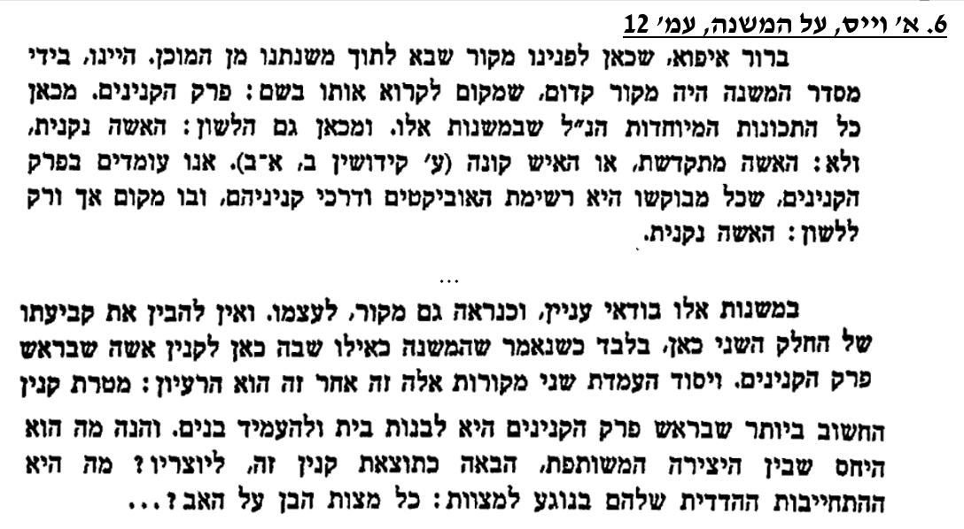
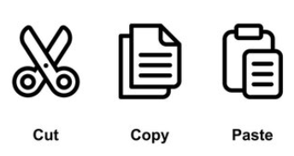
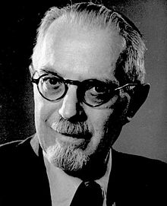
Editorial Process?

Slide 26
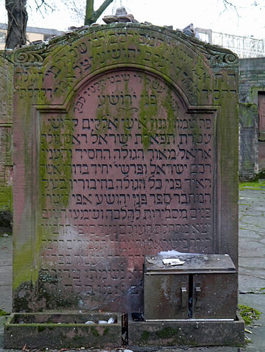
Structure and Meaning?
ר' יהושע פלק (מאה 18) פני יהושע, קידושין, כט ע"א
ועוד נראה דרבינו הקדוש לאחר שסידר כל קנינין שבעולם במה נקנין, ושיש חילוק בכמה דברים בין קניין האיש לקניני האשה... ובין עבד לאמה, וכל זה בקנייני העולם הזה, חזר לפרש קנין העולם האמיתי דלעולם הבא, שאינו נקנה בשום דבר מהקניינים הקודמין שקונין קניני העולם הזה אלא בשכר קיום המצות.
כדאיתא במשנה דסוף פירקין: "כל העושה מצוה אחת מטיבין לו ונוחל הארץ", והיינו עולם הבא. ולפי שאינו דומה מצווה ועושה משום הכי הקדים מצוה הנוהגת בזכרים ולא בנקיבות, ומה שנוהג בשניהם, ומה שנוהג בארץ ולא בחוצה לארץ, עד סוף הפרק. כן נראה לי:

Slide 27
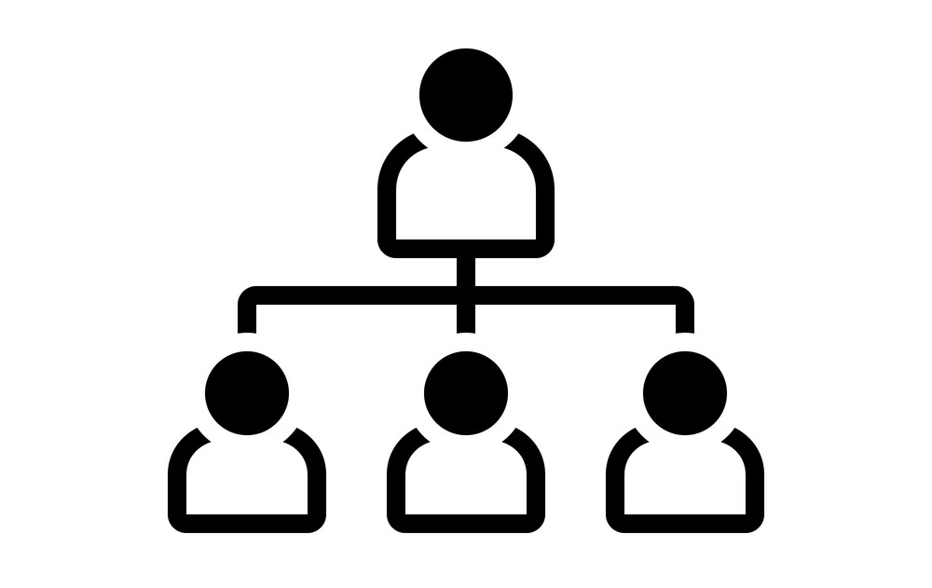
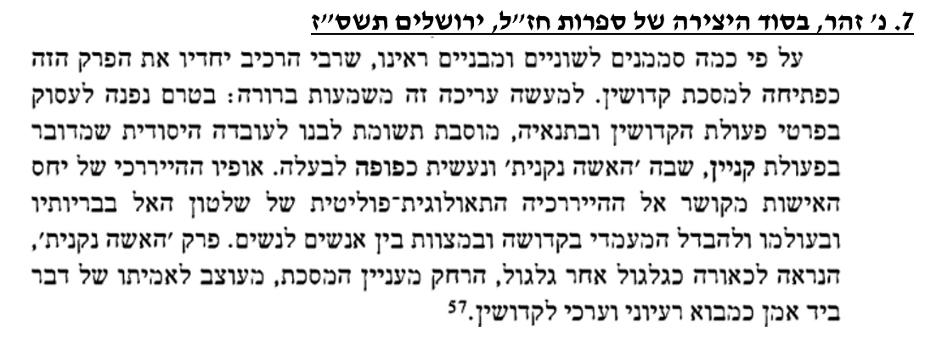
Marriage and Hierarchy?

Slide 28
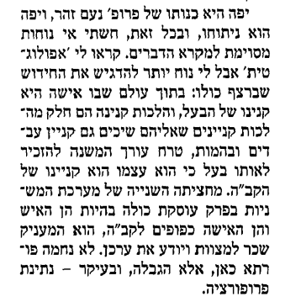
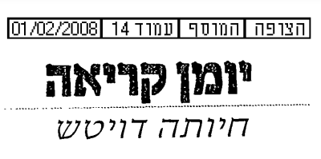
Marriage and Hierarchy?

Slide 29
Structure and Meaning
משנת מסכת קידושין, פרק א
(א) הָאִשָּׁה נִקְנֵית בְּשָׁלשׁ דְּרָכִים, וְקוֹנָה אֶת עַצְמָהּ בִּשְׁתֵּי דְרָכִים. נִקְנֵית בְּכֶסֶף, בִּשְׁטָר, וּבְבִיאָה. בְּכֶסֶף, בֵּית שַׁמַּאי אוֹמְרִים, בְּדִינָר וּבְשָׁוֶה דִינָר. וּבֵית הִלֵּל אוֹמְרִים, בִּפְרוּטָה וּבְשָׁוֶה פְרוּטָה. וְכַמָּה הִיא פְרוּטָה? אֶחָד מִשְּׁמֹנָה בָאִסָּר הָאִיטַלְקִי. וְקוֹנָה אֶת עַצְמָהּ בְּגֵט וּבְמִיתַת הַבָּעַל. הַיְבָמָה נִקְנֵית בְּבִיאָה. וְקוֹנָה אֶת עַצְמָהּ בַּחֲלִיצָה וּבְמִיתַת הַיָּבָם:
(י) כָּל הָעוֹשֶׂה מִצְוָה אַחַת, מְטִיבִין לוֹ וּמַאֲרִיכִין לוֹ יָמָיו וְנוֹחֵל אֶת הָאָרֶץ. וְכָל שֶׁאֵינוֹ עוֹשֶׂה מִצְוָה אַחַת, אֵין מְטִיבִין לוֹ וְאֵין מַאֲרִיכִין לוֹ יָמָיו וְאֵינוֹ נוֹחֵל אֶת הָאָרֶץ. כָּל שֶׁיֶּשְׁנוֹ בַמִּקְרָא וּבַמִּשְׁנָה וּבְדֶרֶךְ אֶרֶץ, לֹא בִמְהֵרָה הוּא חוֹטֵא, שֶׁנֶּאֱמַר: "וְהַחוּט הַמְשֻׁלָּשׁ לֹא בִמְהֵרָה יִנָּתֵק". וְכָל שֶׁאֵינוֹ לֹא בַמִּקְרָא וְלֹא בַמִּשְׁנָה וְלֹא בְדֶרֶךְ אֶרֶץ, אֵינוֹ מִן הַיִּשּׁוּב:

Slide 30
נחלה: אישה וארץ

Slide 31
Mishnah In-Depth: Kiddushin
Drisha 2024

